Slide 1
ECE/CS 552: Performance Metrics
Boone Severson
Lecture notes based in part on slides created by Joshua San Miguel, Mikko Lipasti, Mark Hill, David Wood, Guri Sohi, John Shen and Jim Smith

Slide 2
What is this MIPS instruction?
In binary:
00000000000000000000000000000000
opcode

Slide 3
What is this MIPS instruction?
In binary:
000000 00000 00000 00000 00000 000000
opcode
rs
rt
rd
shamt
funct

Slide 4
What is this MIPS instruction?
In binary:
000000 00000 00000 00000 00000 000000
In assembly:
sll $zero, $zero, 0
    This is a NOP (no-op) instruction
opcode
rs
rt
rd
shamt
funct

Slide 5
Iron Law
Time
Processor Performance = ---------------
Program
=
Instructions
Cycles
Time
X
X
Program
Instruction
Cycle
(dynamic insns)
(CPI)
(cycle time)
Architecture --> Implementation --> Realization
<- <-
Compiler Designer Processor Designer Chip Designer

Slide 6
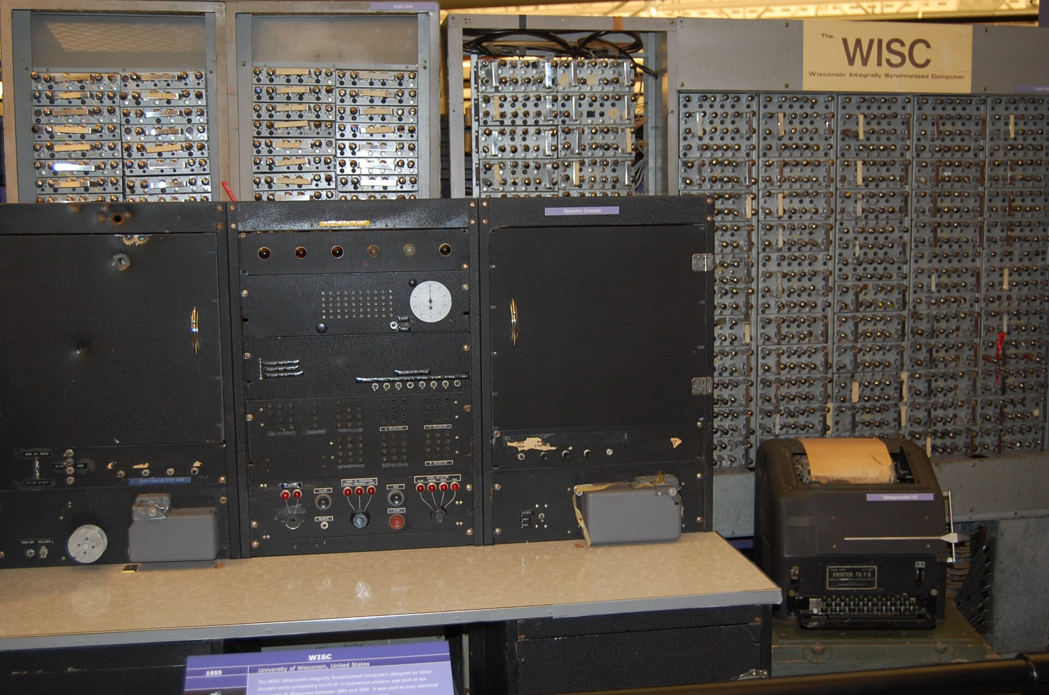
Amdahl’s Law
Motivation for optimizing the common case
Program speedup = old time / new time
Total program speedup when applying an optimization that accelerates a fraction f of time by a factor of s
WISC: Wisconsin Integrally
Synchronized Computer

